Slide 1
Expression evaluation using Priority Linked list
Expression resolution

Slide 2
What is Expression Resolver?
Why called it is called resolver not evaluation ? Because it tries to resolve the expression using priority first then it starts to do evaluation. What is priority linked list ? A single linked list that has priority field which tells which nodes we have to evaluate first. We can use double linked list also, incase of single linked list we can use prev variable to store the previous node. What is a reduce method ? Reduce will do the evaluation on 3 nodes and compress it into 1 node after evaluation and store it in Register/temporary variable. Why we find the priority of an operator not operand node ? Because we need to know both the variables/operand on left-handside and right handside of an operator to do binary operations like +,-,/,* etc.

Slide 3
Why expression resolver ?
For solving the expression using very easy method
Languages that don’t use pointers can also use this method using references.
Removing the tree datastructure/stack as it makes expression evaluation very complex
For compiler designing using expression resolution to emit assembly instruction in very simple method
For designing calculators in high level languages.

Slide 4
Node structure
struct ListNode { struct ListNode* prev; int isOperatorOrOperand; // tells whether this node is an operator or operand int priority; // priority of the operator and operand struct Symbol *str; // pointer to symbol table for operand char op; // operator variable struct ListNode* next; }; List of operators and priority * 4 / 3 + 2 - 1

Slide 5

Structure of the algorithm
Here each operator or operand are store in a single node, one operand or one operator at a time in a node.
isOperatorOrOperand tells whether it is an operand or operator example:- for ‘+’ , isOperatorOrOperand is 1 for ‘2’, isOperatorOrOperand is 0
Priority for operand is decided by nearby operators example:- a+b*c-d*b, here it will compare the operator of ‘*’ and ‘-’ to decide the priority of operand ‘c’, as ‘*’ has greater priority than ‘-’ so c will be assigned with priority of ‘*’ only.

Slide 6
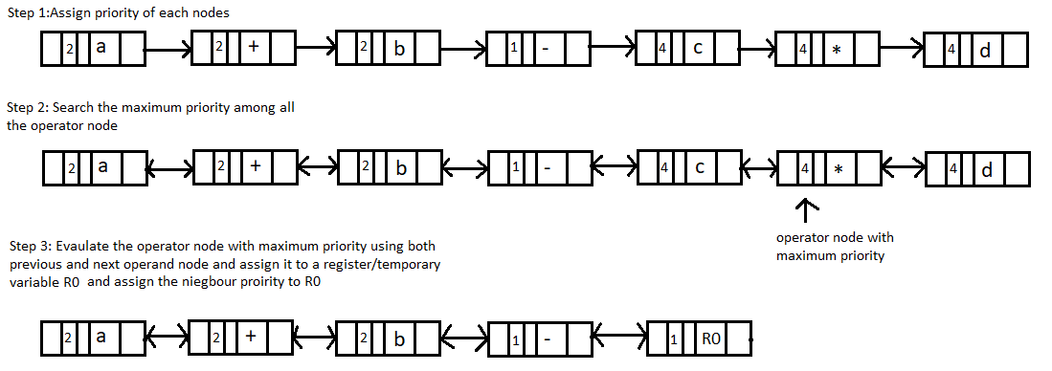
Stepwise Evaluation of Linked List

Slide 7



Stepwise Evaluation of Linked List
Repeat Step 2 Again by finding out the next maximum priority operator here ‘+’ has the maximum priority
Repeat Step 3 Again
Repeat the above procedures until and unless one node remains (head->next == NULL) and return the result when one node is remaining.

Slide 8
How to resolve if braces are there ?
We have a variable defined as blocklevel
on encountering ‘(‘, we increment the blocklevel
on encountering ‘)’, we decrement the blocklevel
we have designed a formula , it is applicable when blocklevel > 0 if(blocklevel > 0) priority = 4*blocklevel+operator_priority; where, operator_priority is given as * 4 / 3 + 2 - 1

Slide 9
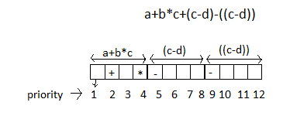
Inside the Formula for braces
if(blocklevel > 0) priority = 4*blocklevel+operator_priority; 4 is added here for expression which are not inside braces and priority for +,-,/* ranges from 1 to 4, example:- a + b *c
Blocklevel determines how many braces inside the expression is, example:- (((a+b))) blocklevel is 3 here
4*Blocklevel + operator_priority tells what should be priority Below example shows how priority values from 1 to 12 is allocated as given for expression ‘a+b*c+(c-d)-((c-d))’

Slide 10
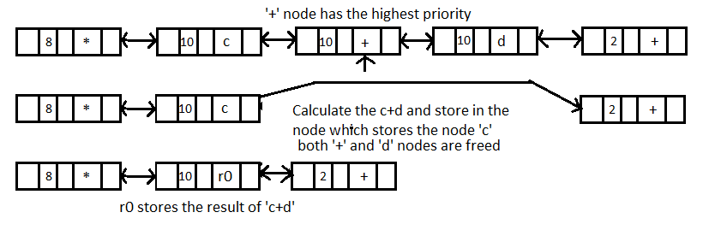
Reduction procedure(reduce)

Slide 11
Stepwise Evaluation of Double Linked List with braces
Braces won’t be inserted inside the linked list, instead we will alter the priority using the formula, if no braces then priority will be based on operator table.
Step 1: Assign priority according to formula for each node
Step 2: go to the highest priority operator node and then calculate c+d and store in R0 register/temp variable

Slide 12

Stepwise Evaluation of Double Linked List with braces
Step 3: goto Maximum priority node and calculate R0*e and assign to R1, take the priority from neighboring node
Step 4: goto Max priority node , calculate a/b and assign to R2 , also take the priority of neighbor for R2 node

Slide 13

Stepwise Evaluation of Double Linked List with braces
Step 5: Terminate the loop as head->next = NULL as only one node is present Fetch the value from R3

Slide 14
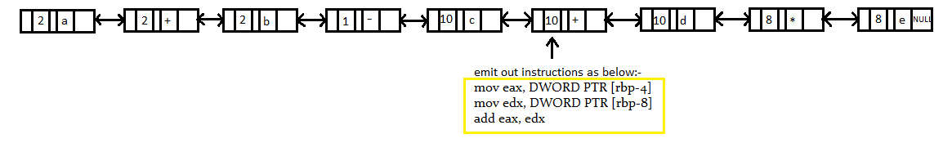
Assembly generation using expression resolver
Step 1: Assign priorities to all the node Step 2: Find the maximum priority among all the node here c+d has maximum priority as 4*2(blocklevel is 2 as 2nd ‘(‘ brace has come) + 2 (priority of ‘+’) = 10
Step 3: emit out the assembly instructions and reduce 3 nodes for ‘c+d’ to one node , result of ‘c+d’ will be stored in eax register

Slide 15
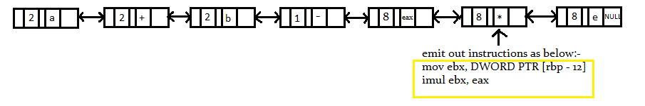
Assembly generation using expression resolver
Step 2 repetition by finding out maximum priority among all the node
Step 3 repetition
Repeat all the steps from step 2 to 3 until one node is left after reduction

